Slide 1
Journeying On and Moving Out – Finding God in a time of change
Could we? Should we?

Slide 2
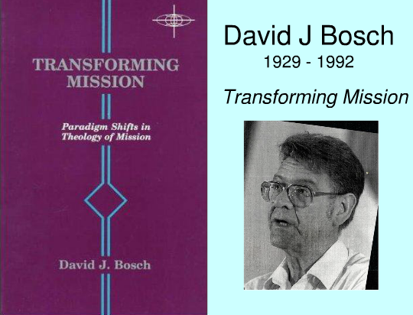
David Bosch and holistic mission HE observes ...
Our understanding and practice of mission has changed throughout the history of the Church
Holistic mission:
Connects working for
the Kingdom of God
(social action) and
witnessing to
the salvation that Jesus brings

Slide 3
And more from David Bosch…
In the west we have allowed ‘salvation’ to be dominant – we read the Gospels as if they were ‘long introductions to the death and resurrection of Jesus’
Holistic mission needs equal attention to the life of Jesus
To achieve holistic mission David Bosch recommends that we take the life of Jesus more seriously

Slide 4
TAKING THE LIFE OF JESUS SERIOUSLY = Venturesome love
Discipleship of the venturesome love type involves more than doing jobs in church!
Could I? Should I? Could we? Should we? The first steps of venturesome love

Slide 5
Getting a clue from Calendar girls! Journeying out

Slide 6
Sewing machines to Zimbabwe
Initial internal conversation … “Could we? Should we?” i.e. an invitation
Anxieties are named and assessed
Gives a story rich life - just what jaded consumers are looking for! (Pine and Gilmore “The Experience Economy”)
An encounter with the raw abrasive side of life… Prayer ‘God help me’, ‘God please help them’ - a ‘thin place’ where only a tissue separates from a sense of God’s presence

Slide 7
Sewing machines to Zimbabwe
Informs decisions across generations
Enables us to see the ‘face of the other’ (Lévinas) counters prejudice, blaming, and over hasty judgements – a disclosure moment
Significance of being ‘ordinary’
The need to be a more ‘moral self’?
And we discover our need of God – because we step out of the comfort of the playpen!

Slide 8
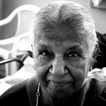
PS A much underestimated force in the world is the power of a radicalised older woman!

Slide 9
“I suspect I started to volunteer to serve breakfast to the homeless as a way of being a more faithful disciple. I did not volunteer to have my heart broken.
However, at the basement door I have come not to a greater confidence in my own good works, but to a deeper awareness of my personal sins and my complicity in sinful systems, as well as to a greater dependence on the grace of Jesus Christ...

Slide 10
In many ways the basement door is a joyful place – a place of handshakes and conversation and fellowship. However, the door also brings with it times of conflict and, almost always a sense of failure and a glimpse of the cross.
The person working the door is the one who has to say “No, you can’t come in yet…there’s no room at the tables…No, you’re too late, we’re not serving breakfast any more.” …

Slide 11
What a revelation this has been! I had always assumed that discipleship followed the confession of sin and the acceptance of forgiveness.
The faltering hospitality offered via the basement door has taught me that the process is actually reversed: we do not fully know the depth of our sin and the reality of God’s grace until we follow the way of Jesus.”
Stanley Saunders and Charles Campbell (2000) “The Word on the Street”, Erdmans: Grand Rapids, Michigan

Slide 12
Initial internal conversation … “Could I? Should I?” “Could we? should we?”
Share with each other occasions when you have had to ponder “Could I? Should I?” “Could we? Should we?”
Does your involvement at St Alphege challenge you to express venturesome love? Could there / should there be more opportunities?

