Slide 1
Journeying On and Moving Out – Finding God in a time of change
Precarious and Anxious:
A Gospel Response

Slide 4
When we are anxious
We react rather than respond, we become more instinctual
Behaviour becomes extreme and unyielding
Exposes and makes vulnerable those who are different – makes use prone to blaming
Can make for emotional distancing (cut-off)
Inclined to ‘herd’- taking on the hurts of others
High anxiety = low resilience
People forget how to have fun together

Slide 5
Responding to high levels of anxiety…
Important to be able to manage one’s own reactive tendencies
Awareness of the danger of over-functioning
Committed to a systems approach rather than monocausal suppositions and blaming
Uses fun, play and festivity (the key role of animateurs)

Slide 6
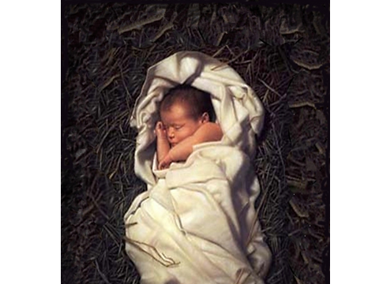
Discipleship for troubled times:
• To be a non-anxious presence in stressful times

Slide 7
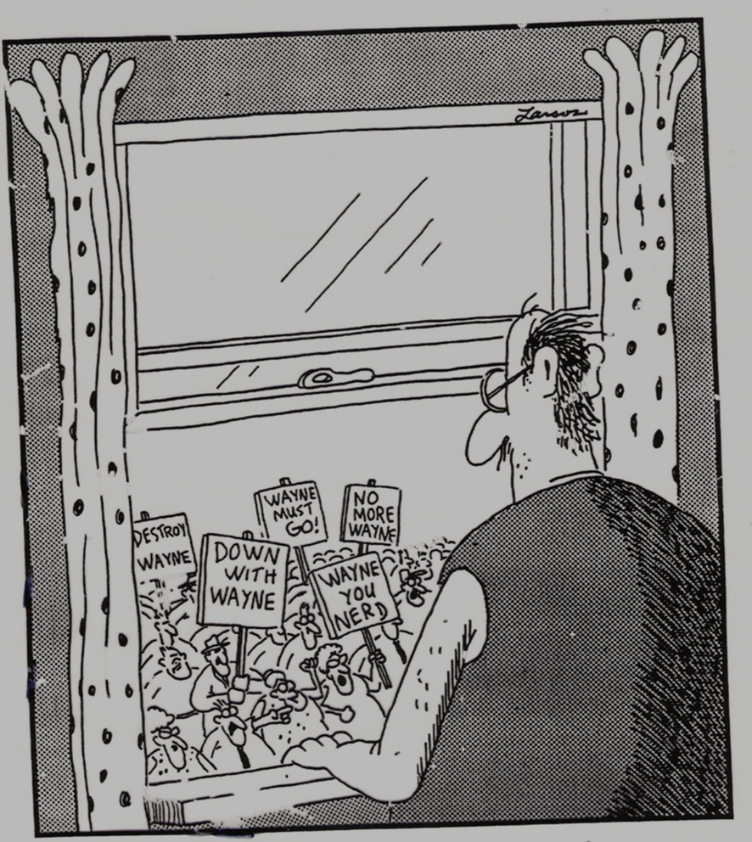
Increasing levels of anxiety exposes and makes vulnerable what is not alike
and leads
to scapegoating

Slide 8
We are in troubling times...
When anxiety turns to fear then scapegoating can move beyond resentment to become vengeful
For those of us who are used to security the temptation becomes that of anticipatory obedience i.e. Anticipating in one’s actions what one anticipates the powerful wish to see happen
In troubled times we have to actively counter our to scapegoat – because Jesus seeks to bring an end to scapegoating

Slide 10
Girard concludes:
That Jesus is the final scapegoat
The New Testament is ‘on the side of’ Jesus, the scapegoat. The Gospels encourage people to see the world through the eyes of the scapegoat.
The scapegoat in the Gospels refuses to let death be the final word and he rises again triumphant
The followers of the scapegoat enact the seizing of the scapegoat, and the scapegoat’s triumph over death, as we do at Holy Communion.

Slide 11
And I conclude ...
Jesus saves not just by dying on the cross and rising again to new life
Jesus also saves by showing us how to live
Our evangelistic message is not just for the sake of our churches or for the Gospel but for the sake of the species homo sapiens

